Slide 1
CSE302||Database Systems (Reference)
Antu Chowdhury
Lecturer,
Dept. of CSE
East West University

Slide 2
Key Constraints
Keys are entity sets used to identify entities within their respective sets uniquely.
Key constraints play a vital role in ensuring the uniqueness of data within a table.

Slide 3
Key
A key in DBMS is an attribute or a set of attributes that help to uniquely identify a tuple (or row) in a relation (or table).
There are broadly seven types of keys in DBMS.
Primary Key
Candidate Key
Super Key
Foreign Key
Composite Key
Alternate Key
Unique Key

Slide 4
An example
Consider a table named ‘Student’
How can we uniquely identify two rows in this table?
Student
Name | Address | Age
Raaj | Dhaka | 21
Nuhash | Chittagong | 23
Raaj | Dhaka | 21

Slide 5
An example
We can add a column named roll
What are the other columns we can use instead of ‘Roll’?
Student
Roll | Name | Address | Age
1 | Raaj | Dhaka | 21
2 | Nuhash | Chittagong | 23
3 | Raaj | Dhaka | 21
Registration_no, NID_no, Phone_no and so on…

Slide 6
Observation
{Roll, Registration_no, NID_no, Phone_no, email … }
We call the collection of all the attributes that can uniquely identify any two tuples or rows in a table, Candidate key
There can be more than one candidate keys in a table.
The Primary Key of a table is selected (the most appropriate one) from one of the candidate keys.
The rest of the keys that remain after choosing the primary key are known as alternate key

Slide 7
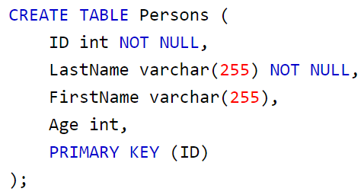
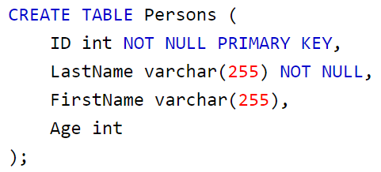
Primary Key
The primary key constraint is used to uniquely identify each record (row) in a database table.
It enforces the uniqueness of values in the specified column or set of columns and ensures that no two records have the same primary key value.
Here ID in the Persons table is defined as primary key

Slide 8
Unique Key
The UNIQUE constraint ensures that all values in a column are different.
The unique constraint ensures that values in a specified column or columns are unique across all rows in a table, but it doesn't require them to be the primary key.
Both the UNIQUE and PRIMARY KEY constraints provide a guarantee for uniqueness for a column or set of columns.
A PRIMARY KEY constraint automatically has a UNIQUE constraint.
However, you can have many UNIQUE constraints per table, but only one PRIMARY KEY constraint per table.

Slide 9
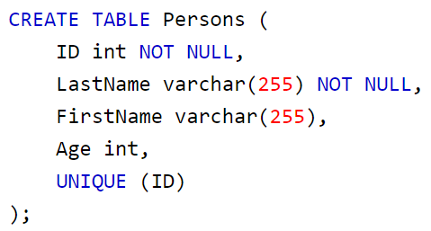
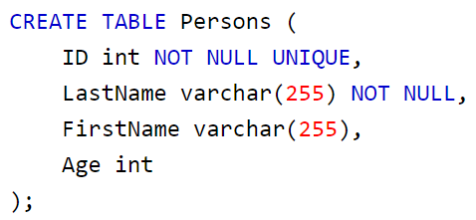
Unique Key
Here The LastName column is defined as it will contain all unique values but it is not necessarily the primary key

Slide 10
Super Key
Combination of all possible attributes that includes at least one candidate key together which can uniquely identify two tuples in a table is super key
Student
Roll | Name | email | Age
1 | Raaj | abc@g.com | 21
2 | Nuhash | def@g.com | 23
3 | Raaj | gdr@g.com | 21

Slide 11
Super Key
Combination of all possible attributes that includes at least one candidate key together which can uniquely identify two tuples in a table is super key
Super Key is the superset of a candidate key.
Super key = Candidate key + 1 or more attribute
Student
Roll | Name | email | Age
1 | Raaj | abc@g.com | 21
2 | Nuhash | def@g.com | 23
3 | Raaj | gdr@g.com | 21

Slide 12
Super Key
Combination of all possible attributes that includes at least one candidate key together which can uniquely identify two tuples in a table is super key
Super Key is the superset of a candidate key.
Super key = Candidate key + 1 or more attribute
Student
Roll | Name | email | Age
1 | Raaj | abc@g.com | 21
2 | Nuhash | def@g.com | 23
3 | Raaj | gdr@g.com | 21

Slide 13
Super Key
Combination of all possible attributes that includes at least one candidate key together which can uniquely identify two tuples in a table is super key
Super Key is the superset of a candidate key.
Super key = Candidate key + 1 or more attribute
Student
Roll | Name | email | Age
1 | Raaj | abc@g.com | 21
2 | Nuhash | def@g.com | 23
3 | Raaj | gdr@g.com | 21

Slide 14
Super Key
Combination of all possible attributes that includes at least one candidate key together which can uniquely identify two tuples in a table is super key
Super Key is the superset of a candidate key.
Super key = Candidate key + 1 or more attribute
Student
Roll | Name | email | Age
1 | Raaj | abc@g.com | 21
2 | Nuhash | def@g.com | 23
3 | Raaj | gdr@g.com | 21

Slide 15
Super Key
Combination of all possible attributes that includes at least one candidate key together which can uniquely identify two tuples in a table is super key
Super Key is the superset of a candidate key.
Super key = Candidate key + 1 or more attribute
Student
Roll | Name | email | Age
1 | Raaj | abc@g.com | 21
2 | Nuhash | def@g.com | 23
3 | Raaj | gdr@g.com | 21

Slide 16
Primary Key vs Unique Key
Feature | Primary Key | Unique Key
Purpose | Main row identifier | Extra unique constraint
NULL allowed | ❌ No | ✅ Yes
Auto increment | ✅ Yes (usually) | ❌ No
Count per table | Only one | Multiple
Can change value | Technically yes, not recommended | Yes

Slide 17
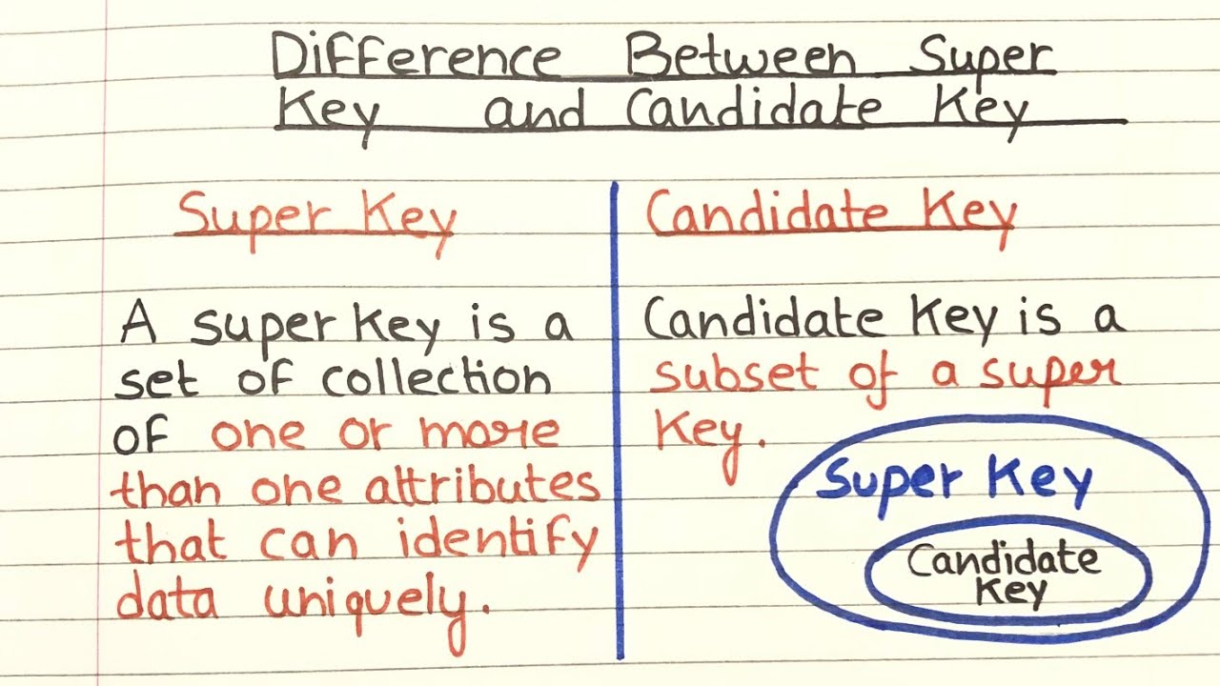
Super Key vs Candidate Key

Slide 18
Foreign Key
a reference link between tables that are known as the primary (or parent) and foreign (or child) tables. The foreign table references one or more columns (the primary key, which can be one or more columns) in the primary table; that is how the link is created.
A FOREIGN KEY is a field (or collection of fields) in one table, that refers to the PRIMARY KEY in another table.

Slide 19
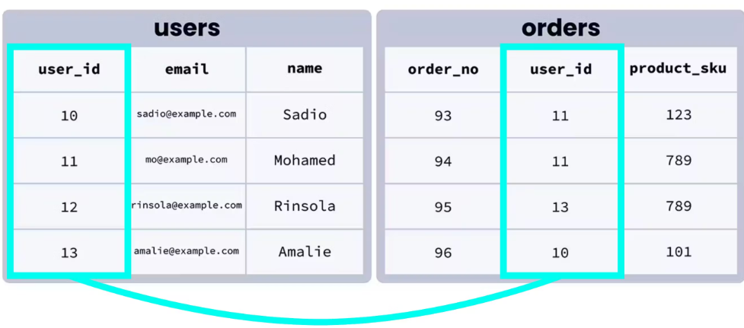
Foreign Key
a FOREIGN KEY on the “user_id" column when the "Orders" table is created
FOREIGN KEY (columnName) REFERENCES tablename(columnName)

Slide 20
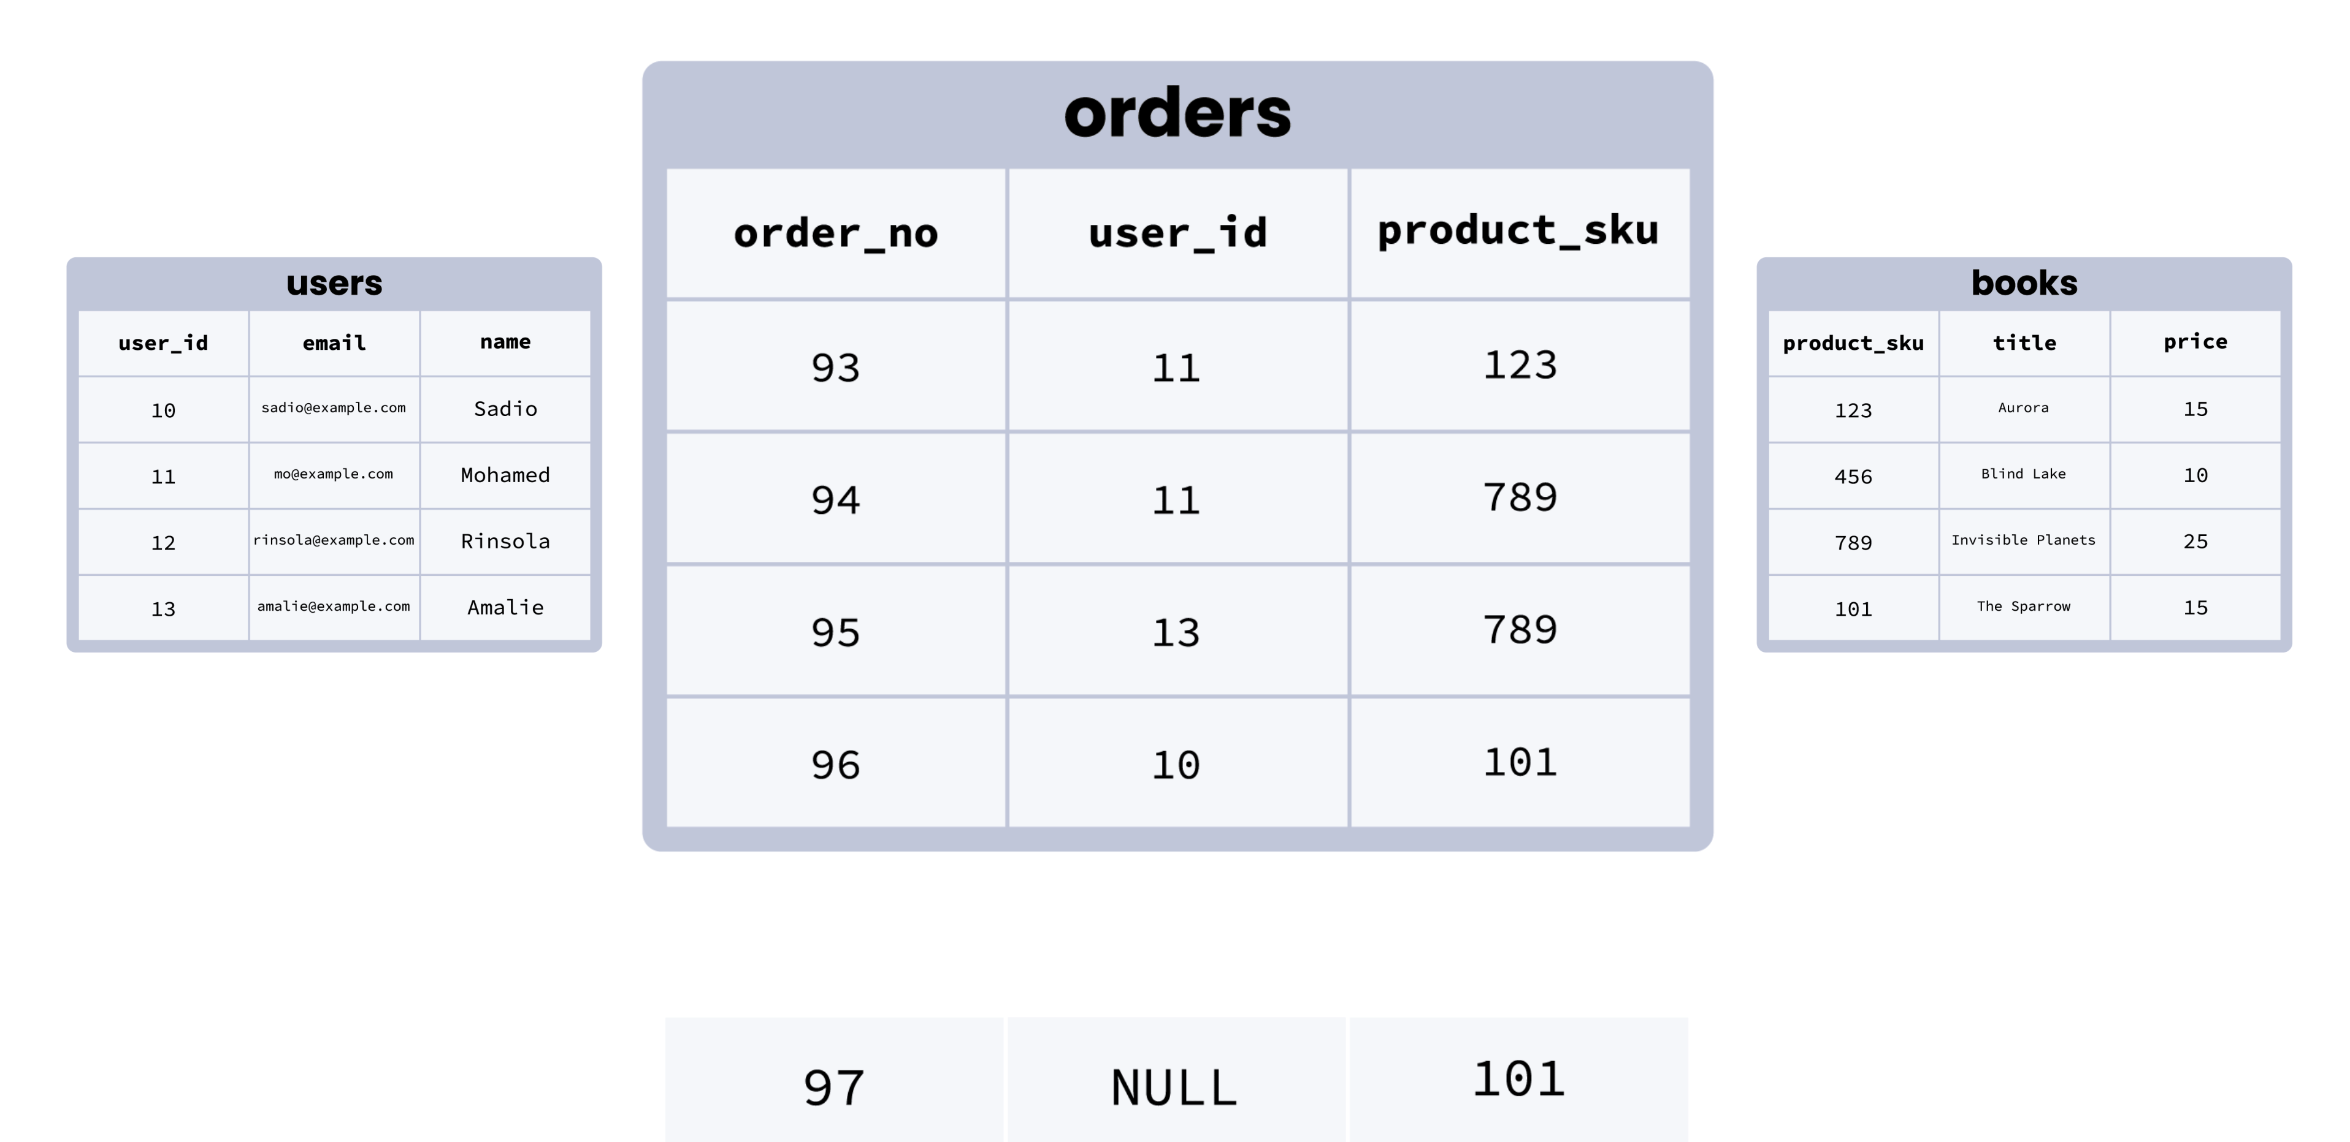
Foreign Key

Slide 21
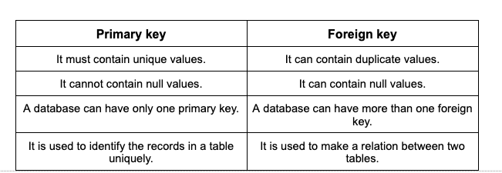
Advantage of Foreign Key
Self study

Slide 22
Thank You

